Slide 1
IPL Data Analysis (Group 7)
Project Presentation
DS5003:DE Project
Dr.Mrinal Das
Team Members:
ANKITA K (142302002)
VISHAL SINGH (142302009)
ABHISHEK S MAYYA (142302014)

Slide 2
Details of Pre-processing
Data Examination:
We addressed missing data in certain columns that are important, such as City-(Sharjah Cricket stadium, Dubai International Cricket Stadium), Season(2007/08=2008), Team names(Name correction), Venue(Name Correction)
Feature Engineering:
We merged certain columns like:
Kind + Fielders involved = caught by R Sai Kishore
wonby + Margin = won by 7 wickets
We will Generate new features as needed, such as calculating run rates, over-by-over statistics, or player performance metrics. Aggregate data at various levels, such as match-level or player-level statistics to derive meaningful insights.

Slide 3
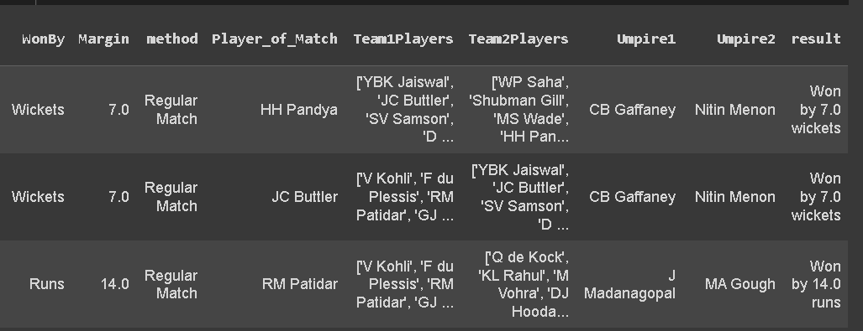
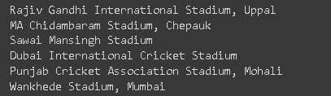

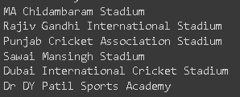

Slide 4
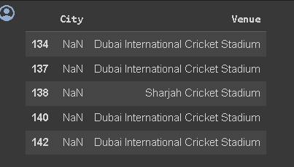
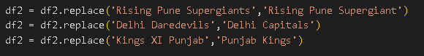
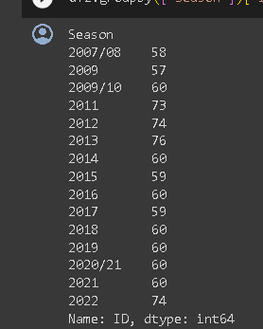
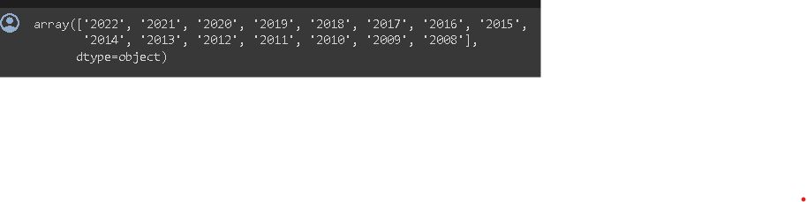

Slide 5
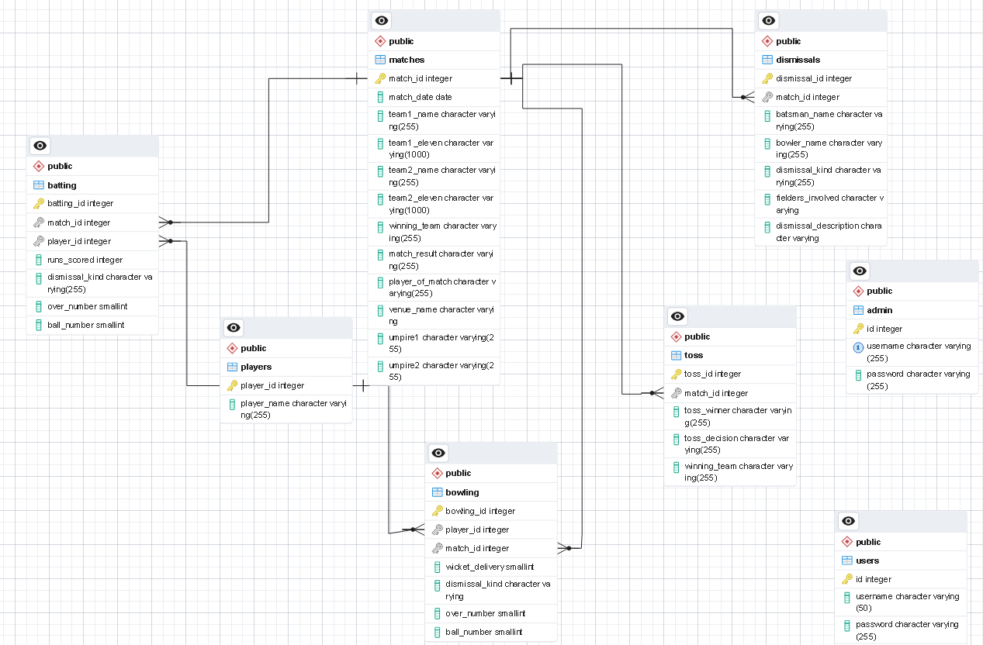
Database Schema

Slide 6
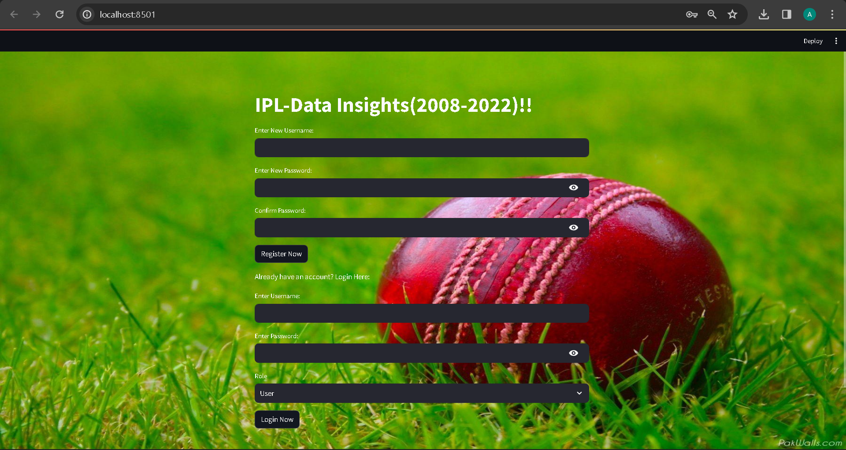
Dashboard

Slide 7
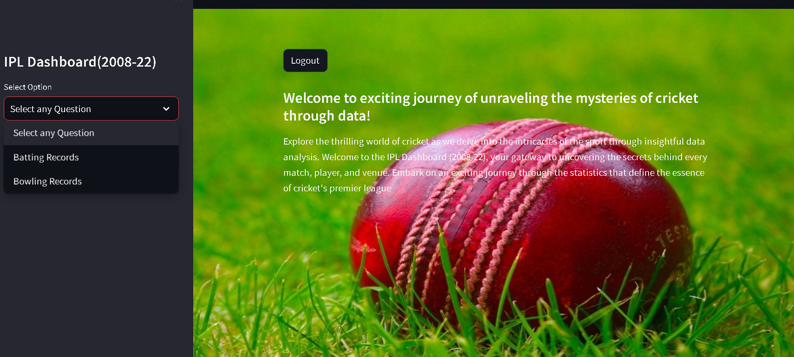

Slide 8
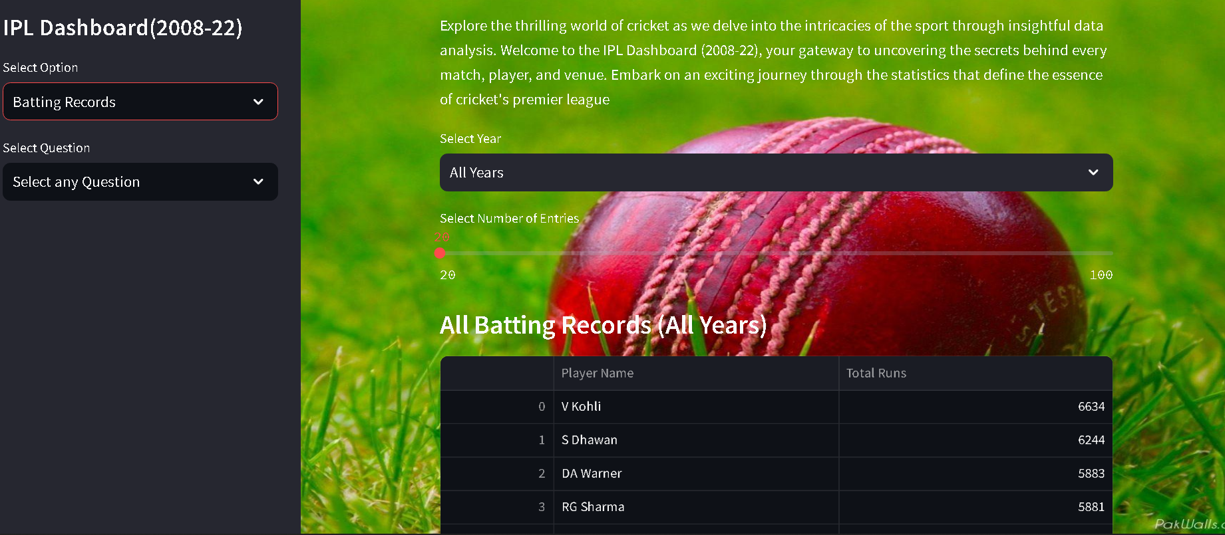

Slide 9
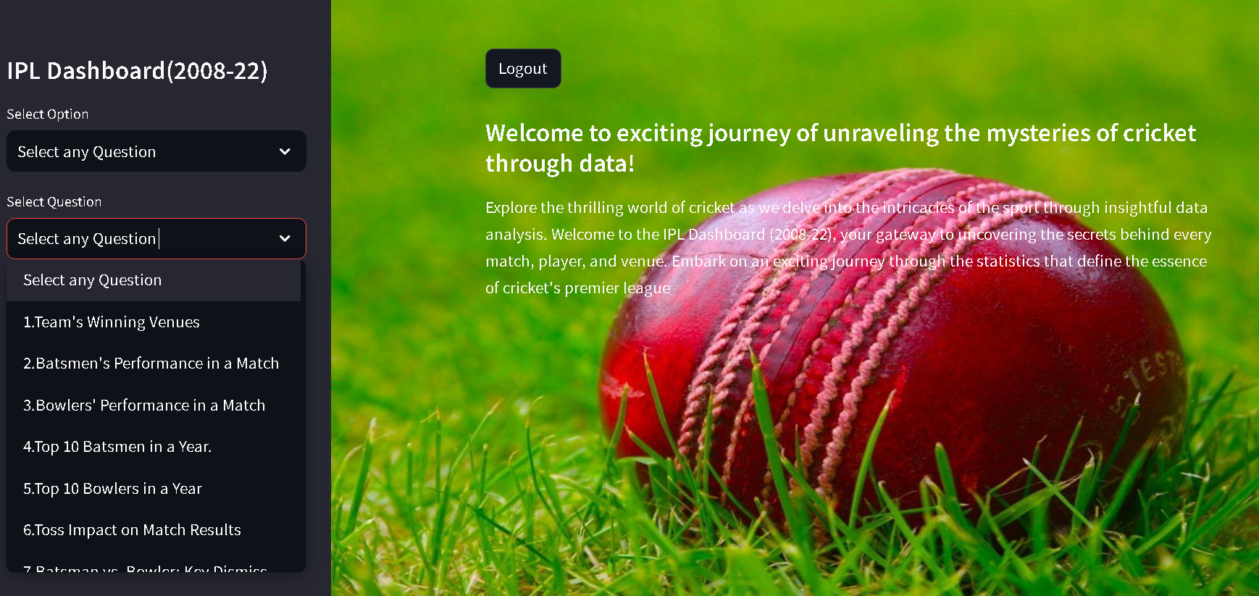

Slide 10
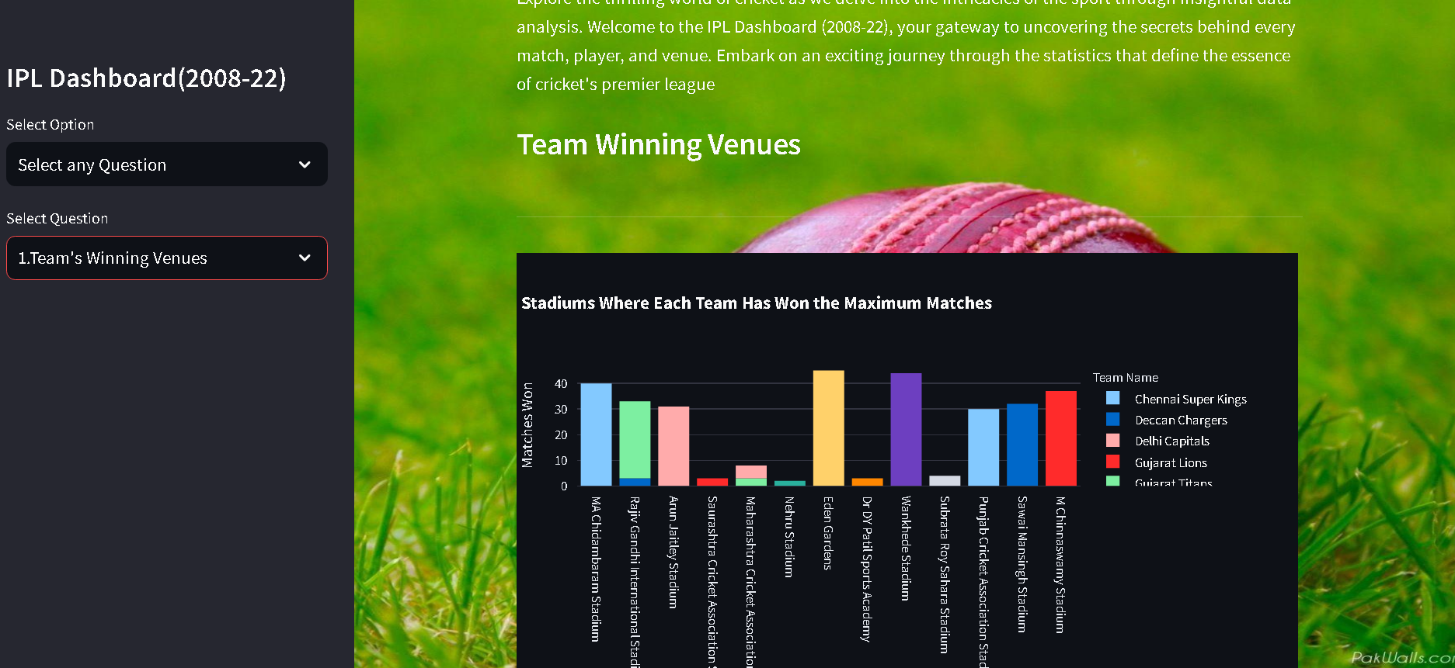

Slide 11
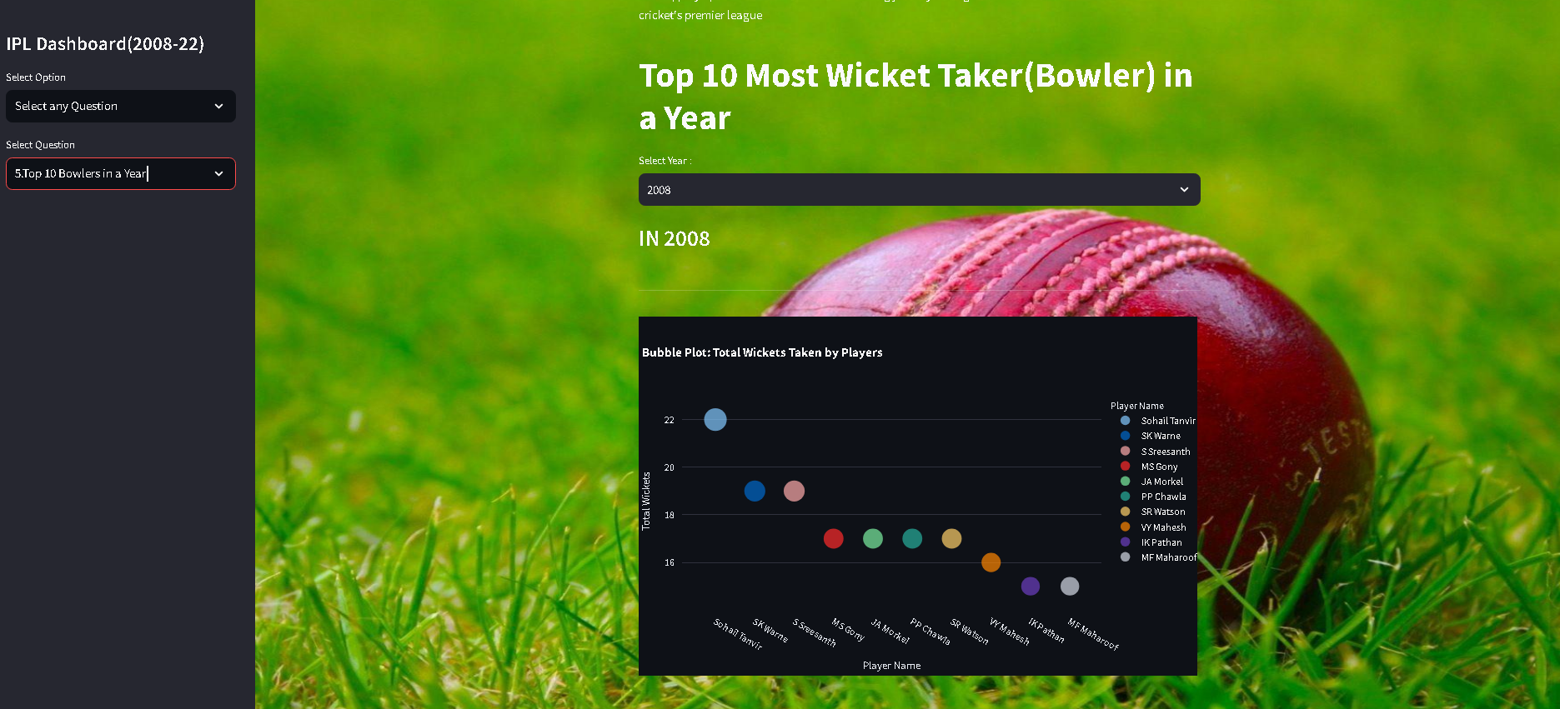

Slide 12
Tools and Libraries
• Pre-processing in google colab: Pandas, NumPy
• Database Management: PostgreSQL,VS code,psycopg2 to interaction of python application with postgresql
• Visualization: Matplotlib, Seaborn,plotly for creating interactive charts and graphs.
• Dashboard: Streamlit for creating a dashboard

Slide 13
INDIVIDUAL CONTRIBUTIONS
1.ANKITA K
Responsible for designing the dashboard, login/register pages, and associated backend code.
Handling SQL queries and contributing to visualization aspects
2.VISHAL SINGH
Focus on preprocessing the dataset and some SQL queries.
Responsible for visualizing the queries in the dashboard.
3.ABHISHEK S MAYYA
Involved in designing the database and crafting SQL queries.
Takes charge of the Batting and Bowling Record section in the dashboard.

Slide 14
Thank You

